Slide 1
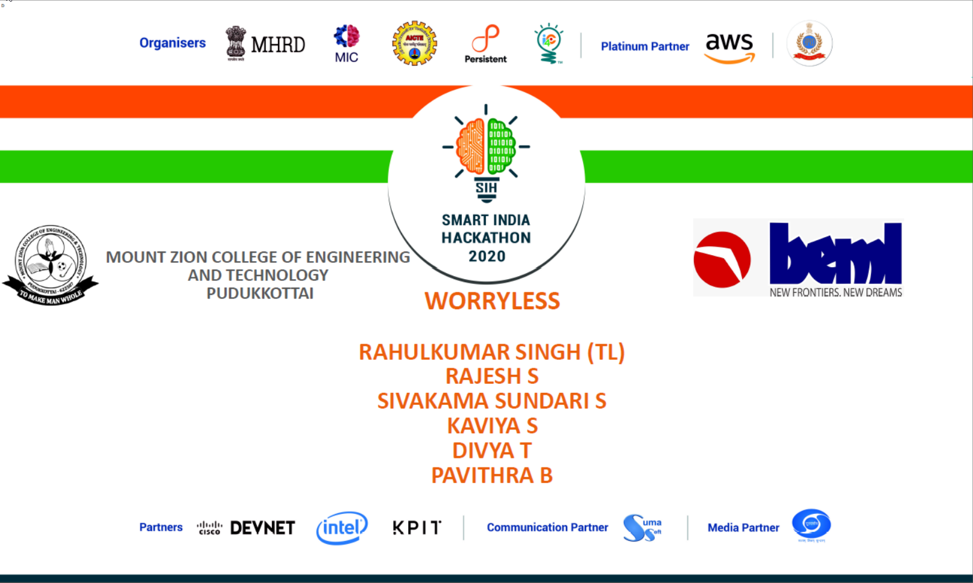

Slide 2
BH60M & BH100 with Electronic Transmission
Securing the CAN J1939 2.0B Communication Protocol, to make RIDES SAFER!

Slide 3
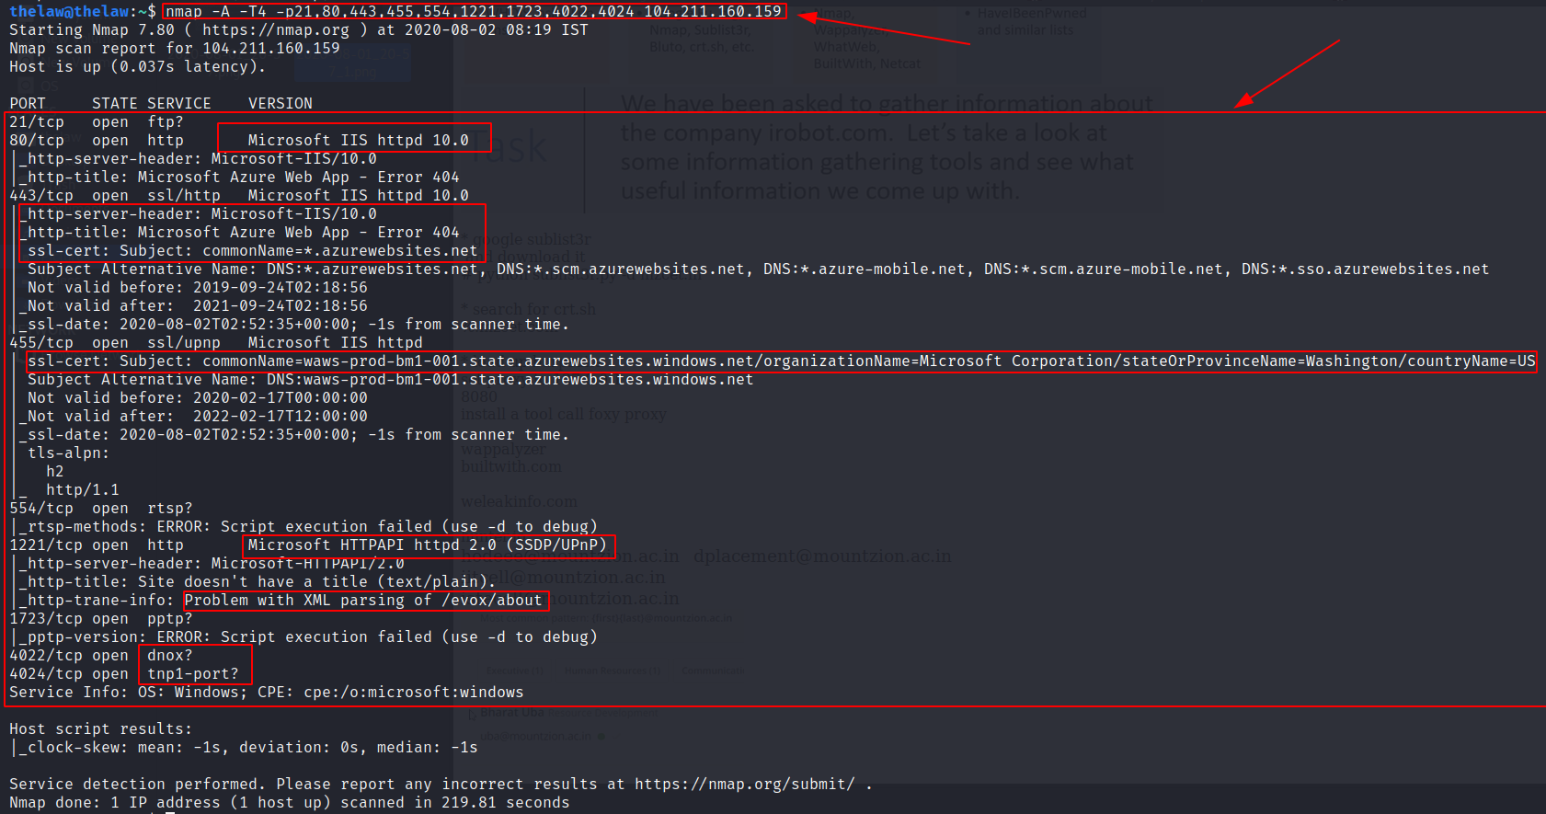
Hacking http://rnddev.azurewebsites.net/
Scanning and Enumeration
In-depth scanning of open ports using nmap tool:

Slide 4
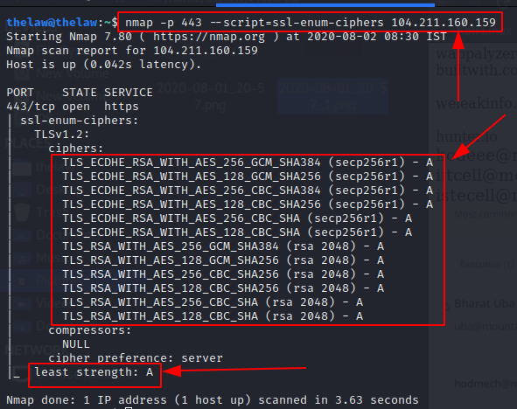
Hacking http://rnddev.azurewebsites.net/
Scanning and Enumeration
Checking the strength of ciphers nmap tool: (Ciphers are strong)

Slide 5
Hacking http://rnddev.azurewebsites.net/
Scanning and Enumeration
Checking the strength of ciphers nmap tool: (Ciphers are strong)

Slide 6
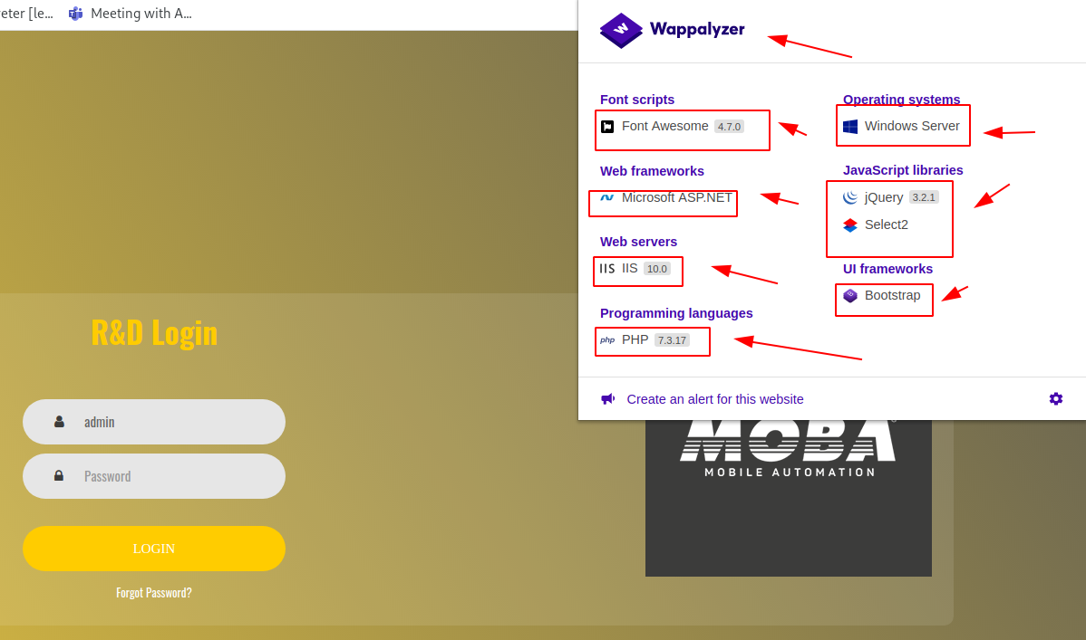
Hacking http://rnddev.azurewebsites.net/
Scanning and Enumeration
Details of the website using Wappalyzer

Slide 7
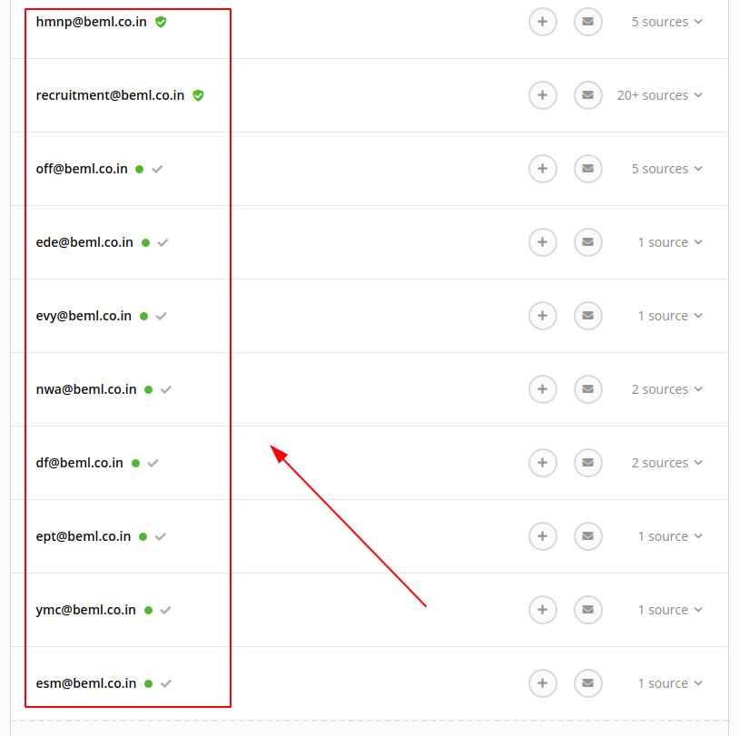
Hacking http://rnddev.azurewebsites.net/
Scanning and Enumeration
Found email addresses related to beml.co.in using hunter.io tool

Slide 8
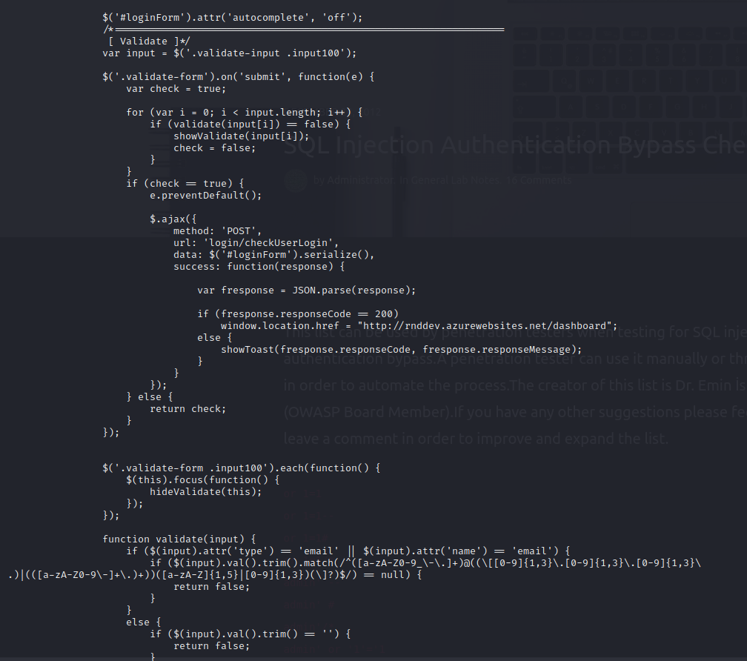
Hacking http://rnddev.azurewebsites.net/
Scanning and Enumeration
Found email addresses related to beml.co.in using hunter.io tool

Slide 9
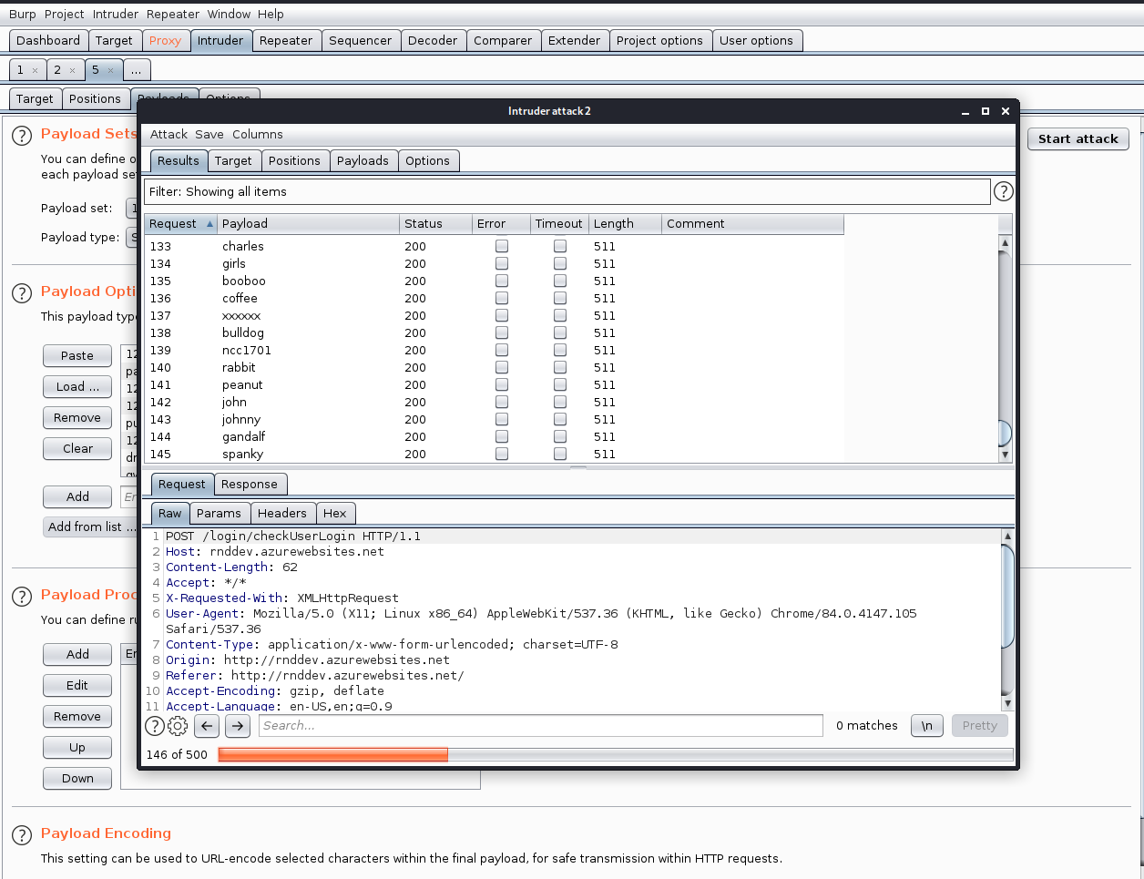
Hacking http://rnddev.azurewebsites.net/
Exploitation
Sniper Attack using BurpSuit:

Slide 10
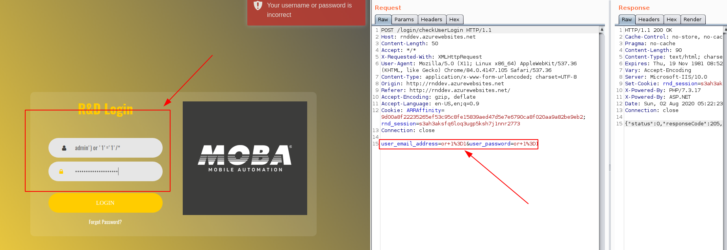
Hacking http://rnddev.azurewebsites.net/
Exploitation
SQL Injection

Slide 11
Hacking http://rnddev.azurewebsites.net/
Exploitation
Further Exploitation Plans
Brute Force Attack
URL Injection
Directory Traversal
SQL Injection via AJAX request with JSON response

